Slide 1
Causal Project
A/B Testing on
App’s Booking Page
Group 10: Yu Chun Peng, Chien-Chu Hsu, Chia-Yen Ho, Ng Ka Lok Carol

Slide 2

Roadmap
Problem
& Data
Threats to
Causal Inference
Experiment
1
3
5
2
4
6
Experiment Hypothesis
Visualization
& Check
Recommendations
& Limitations

Slide 3
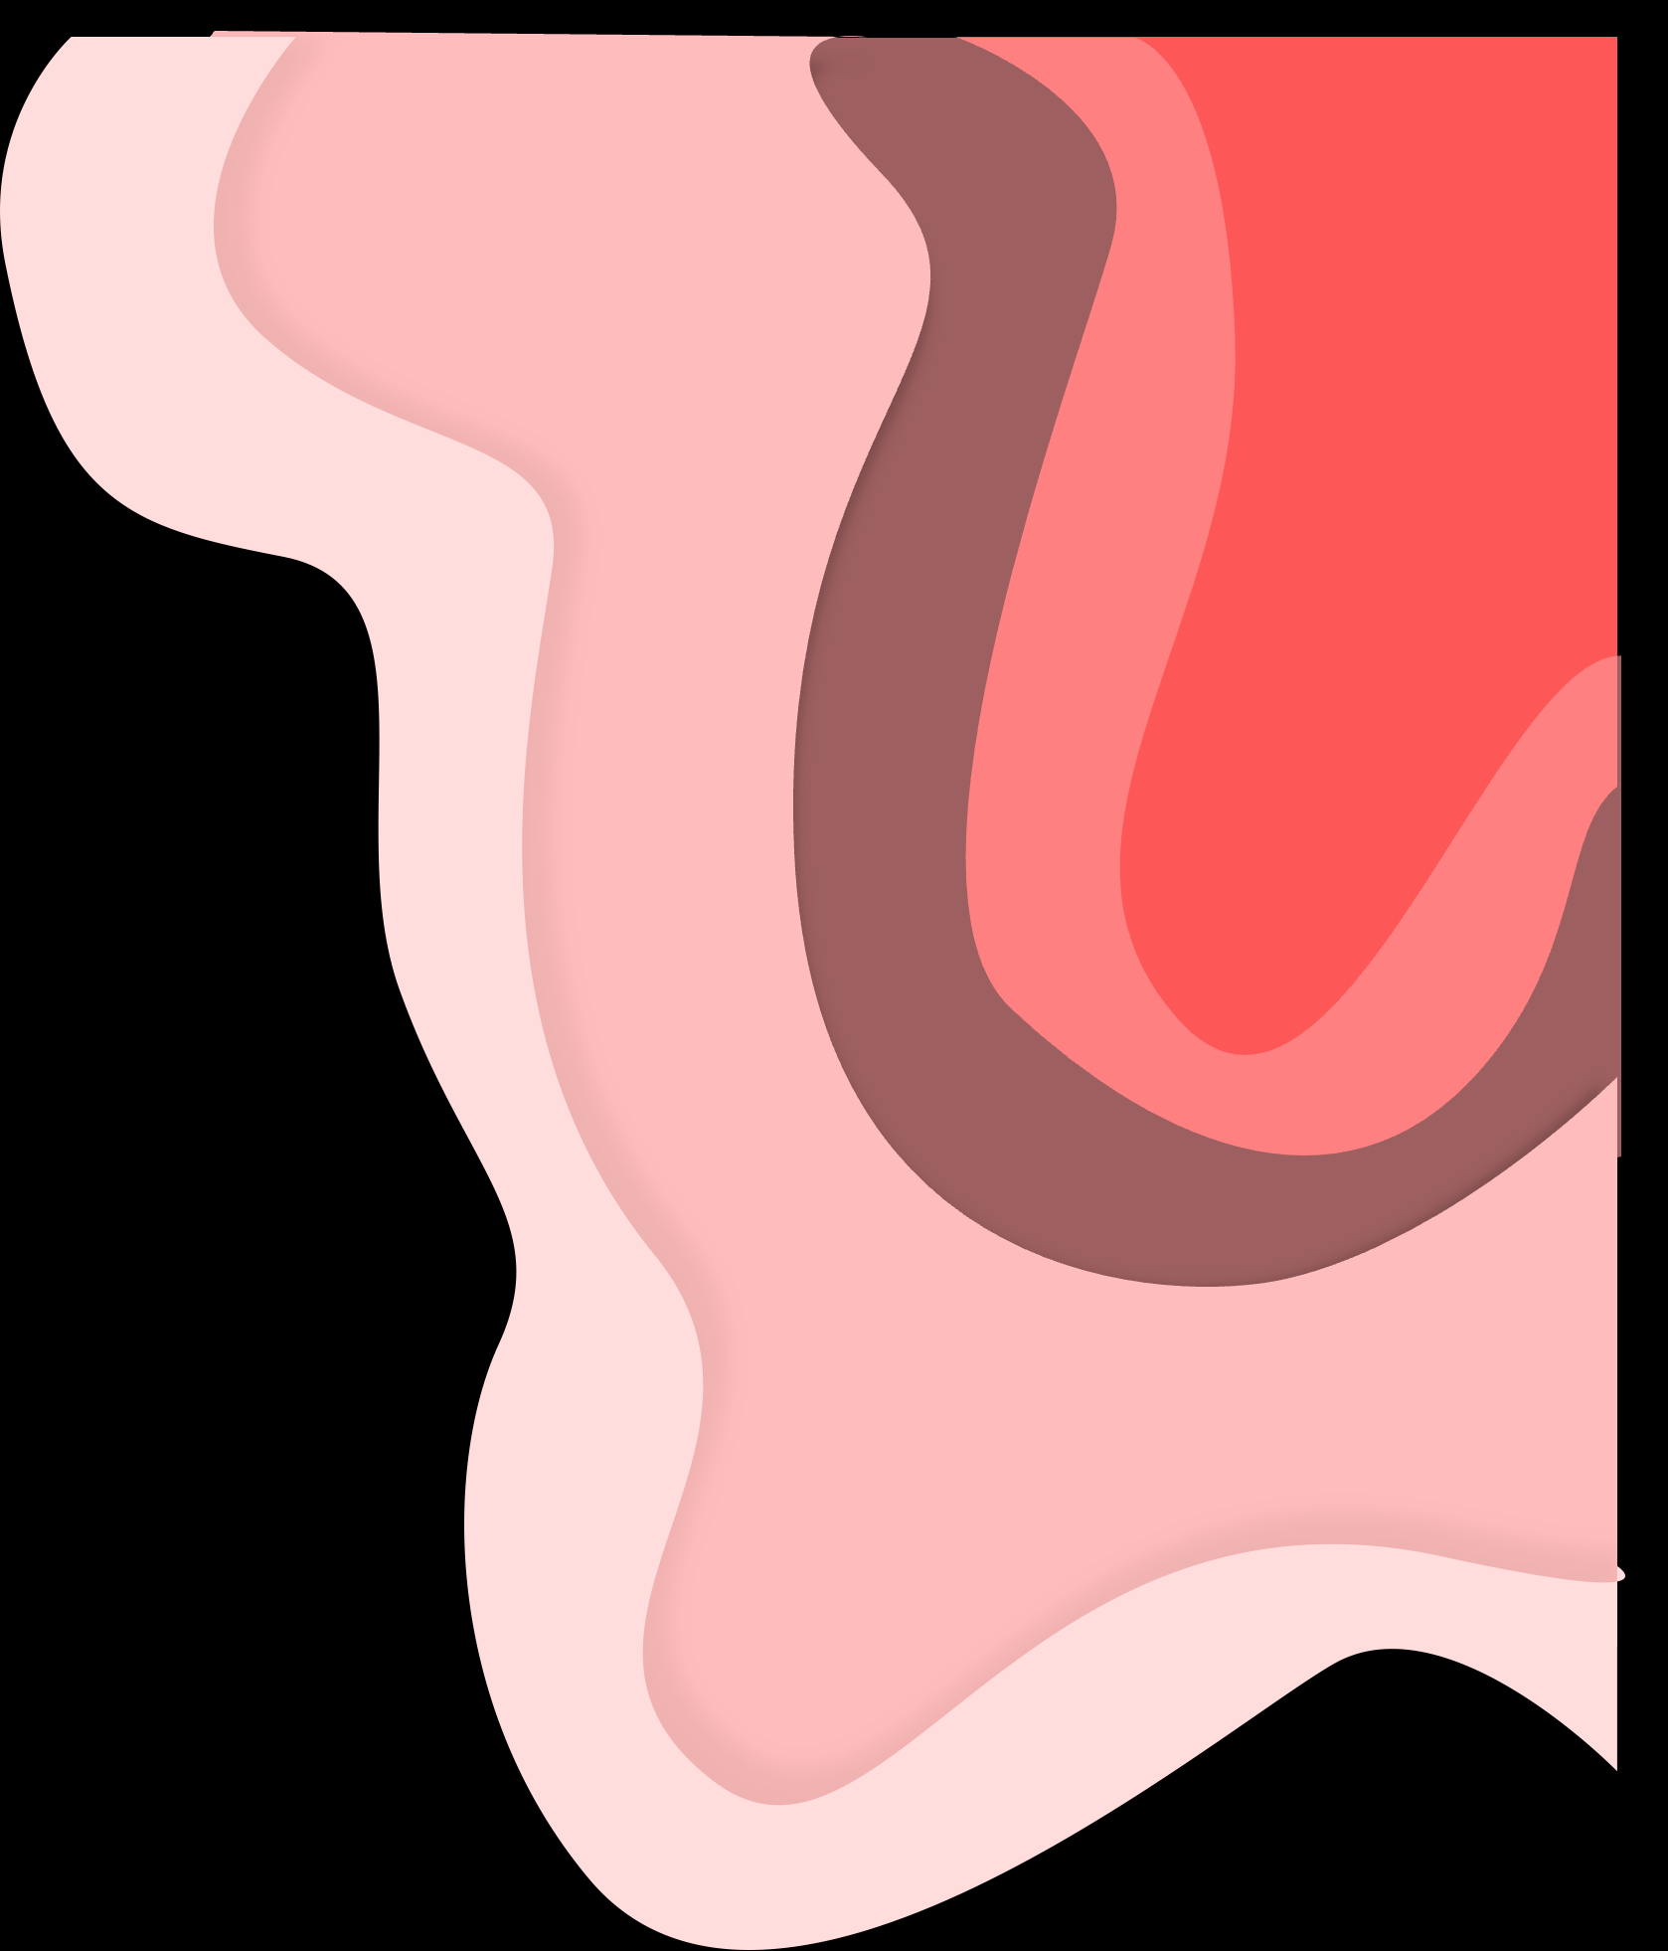
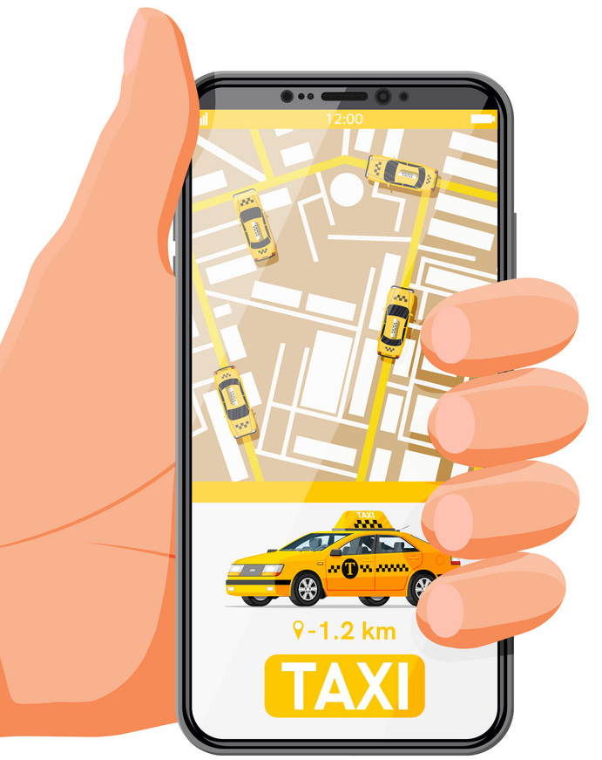


Background
Flyber app provides a flying-taxi service in one of the most congested cities in America - New York City.
See More

Slide 4
User Journey of Booking Page
Open Flyber
1
Enter
Number of Riders
2
Search Vehicle
3
Begin Ride
4

Slide 5
User Journey of Booking Page
Open Flyber
Low Conversion Rate
1
Enter
Number of Riders
2
Search Vehicle
3
Begin Ride
4

Slide 6
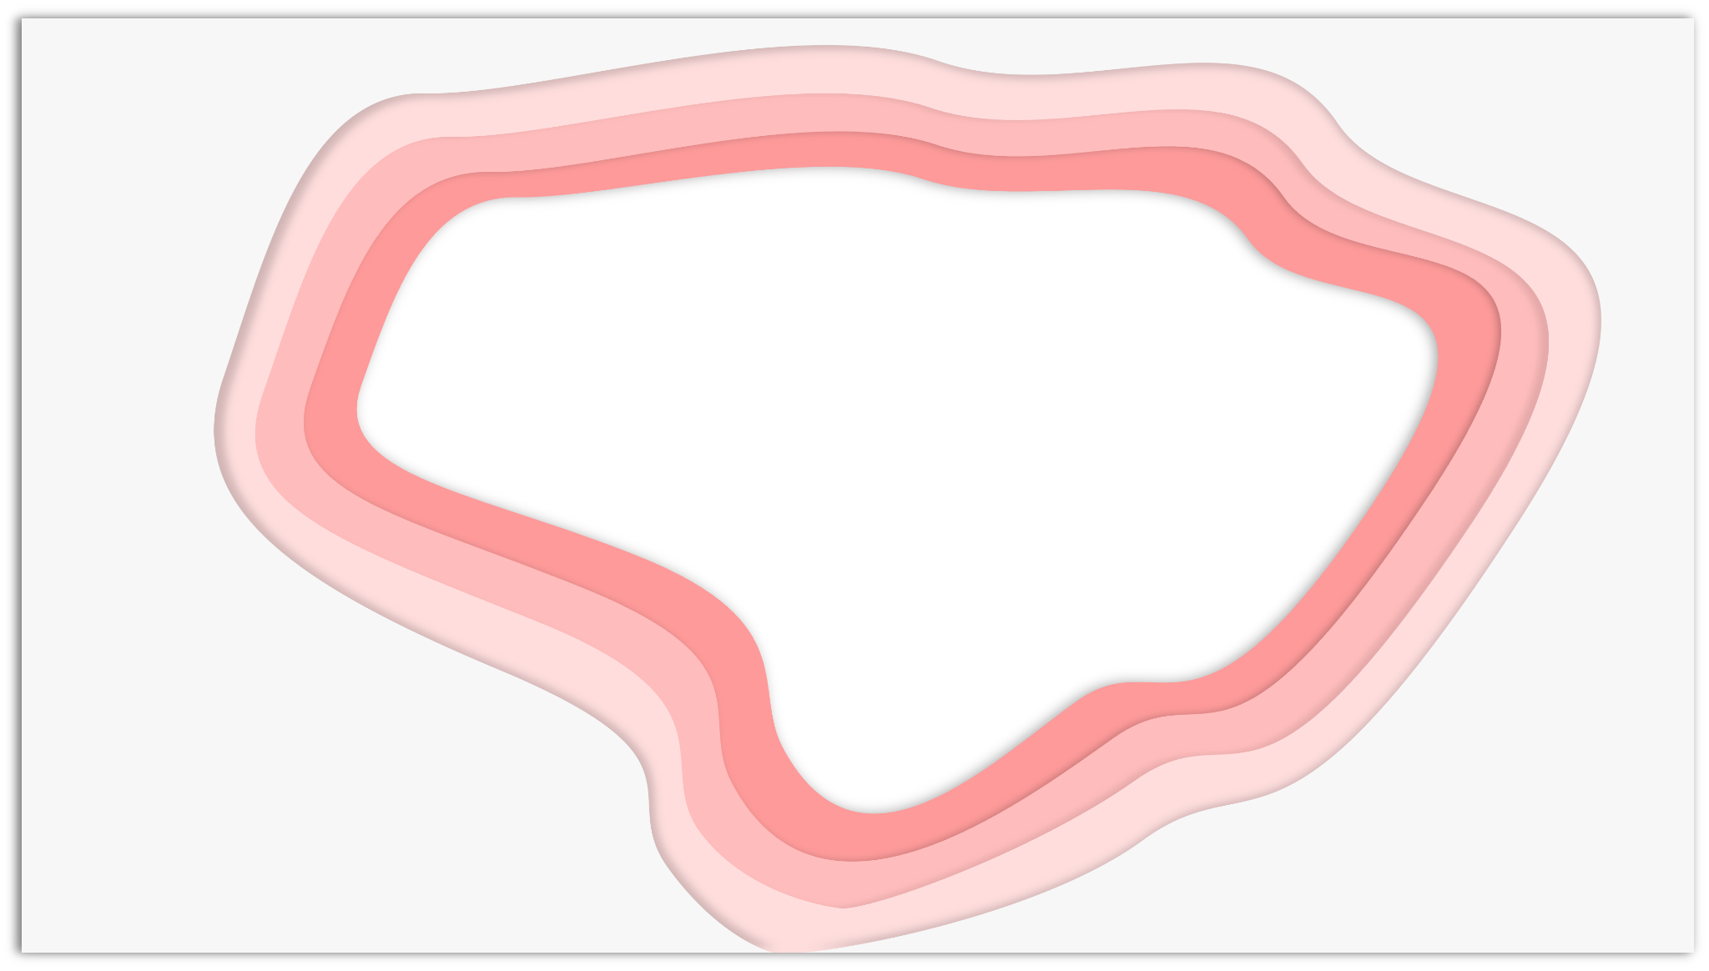


Problems for Flyber
How people engage with the booking page?
How can we improve UI/UX to generate
more bookings?

Slide 7

Dataset Description
user_uuid - an unique id for each user
experiment - group - to identify 1 original and 2 experiment versions
event_uuid - trip booking event id
event_time - time when user triggered a trip
age - four age groups including 18-29, 30-39, 40-49 and 50+
session_uuid - an unique id for each session
user_neighborhood - neighborhoods in New York City
event_type - indicates the stage of user journey

Slide 8
Roadmap
Problem
& Data
Threats to
Causal Inference
Experiment
1
3
5
2
4
6
Experiment Hypothesis
Visualization
& Check
Recommendations
& Limitations

Slide 9
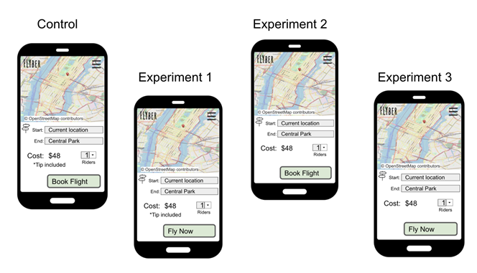
Experiment hypothesis
Hypothesis 1: Redesign the text on the booking button would drive more conversions
Control
Treatment 1

Slide 10
Experiment hypothesis
Hypothesis 1: Redesign the text on the booking button would drive more conversions
Control
Treatment 1

Slide 11
Experiment hypothesis
Hypothesis 1: Redesign the text on the booking button would drive more conversions
Hypothesis 1: Redesign the text on the booking button would drive more conversions
Hypothesis 2: Remove “Tip included” text would drive more conversions
Control
Treatment 1
Treatment 2

Slide 12
Experiment hypothesis
Hypothesis 1: Redesign the text on the booking button would drive more conversions
Hypothesis 1: Redesign the text on the booking button would drive more conversions
Hypothesis 2: Remove “Tip included” text would drive more conversions
Control
Treatment 1
Treatment 2

Slide 13
Roadmap
Problem
& Data
Threats to
Causal Inference
Experiment
1
3
5
2
4
6
Experiment Hypothesis
Visualization
& Check
Recommendations
& Limitations

Slide 14
Threats to Causal Inference
Omitted Variable Bias
User’s decisions might be affected by other variables e.g. salary
Selection Bias
Users could share the same preference or habit of riding
1
2
Users might not be aware of design change
Measurement Error
No obvious simultaneity bias in this case
Simultaneity Bias
3
4

Slide 15
Roadmap
Problem
& Data
Threats to
Causal Inference
Experiment
1
3
5
2
4
6
Experiment Hypothesis
Visualization
& Check
Recommendations
& Limitations

Slide 16
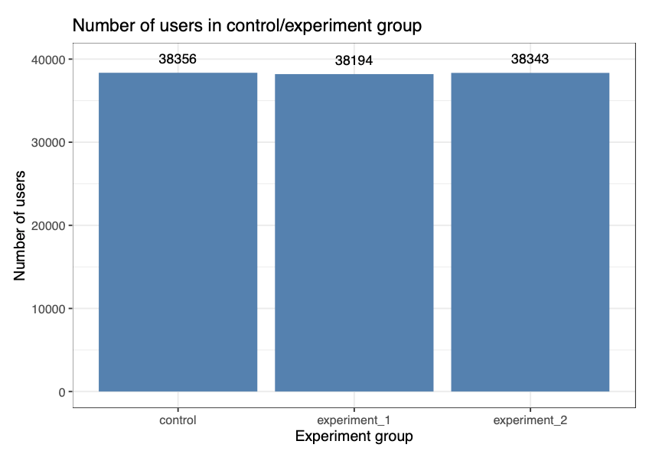
Visualization
Number of users in each group are equal
Control group 38356 users
Experiment group 1: 38194 users
Experiment group 2: 38343 users

Slide 17
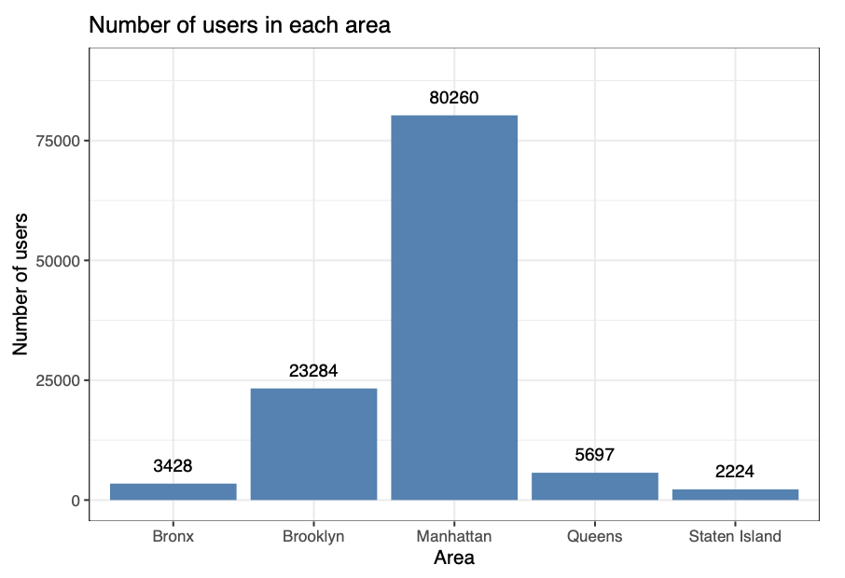
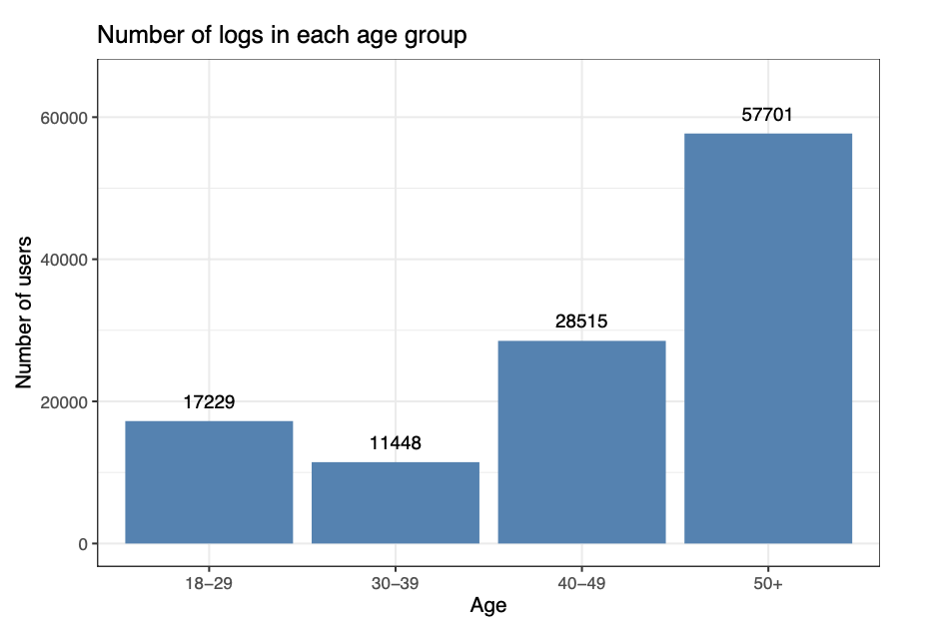
Visualization
Distribution of Variables
Area across Bronx, Brooklyn, Manhattan, Queen, and Station Island
Age group contains 18-29, 30-39, 40-49 and 50+

Slide 18
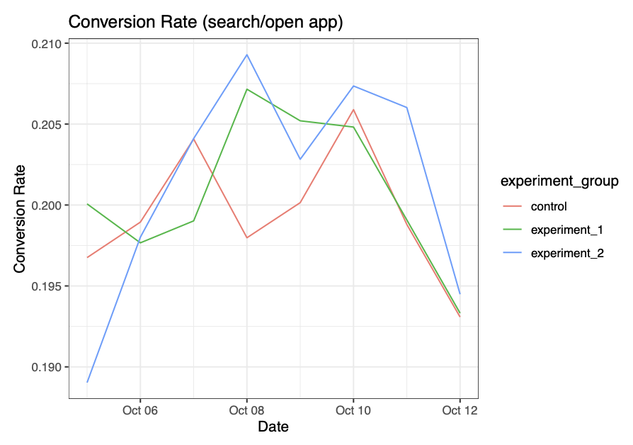
Visualization
Conversion Rate
Conversion rates are between 19% to 21%
Experiment group 2 has a roughly higher conversion rate compared to other groups
* Conversion rate: the percentage of users open and search on the app divided by users open the app
Notes:
Conversion rate: the percentage of users open and search on the app divided by users open the app

Slide 19
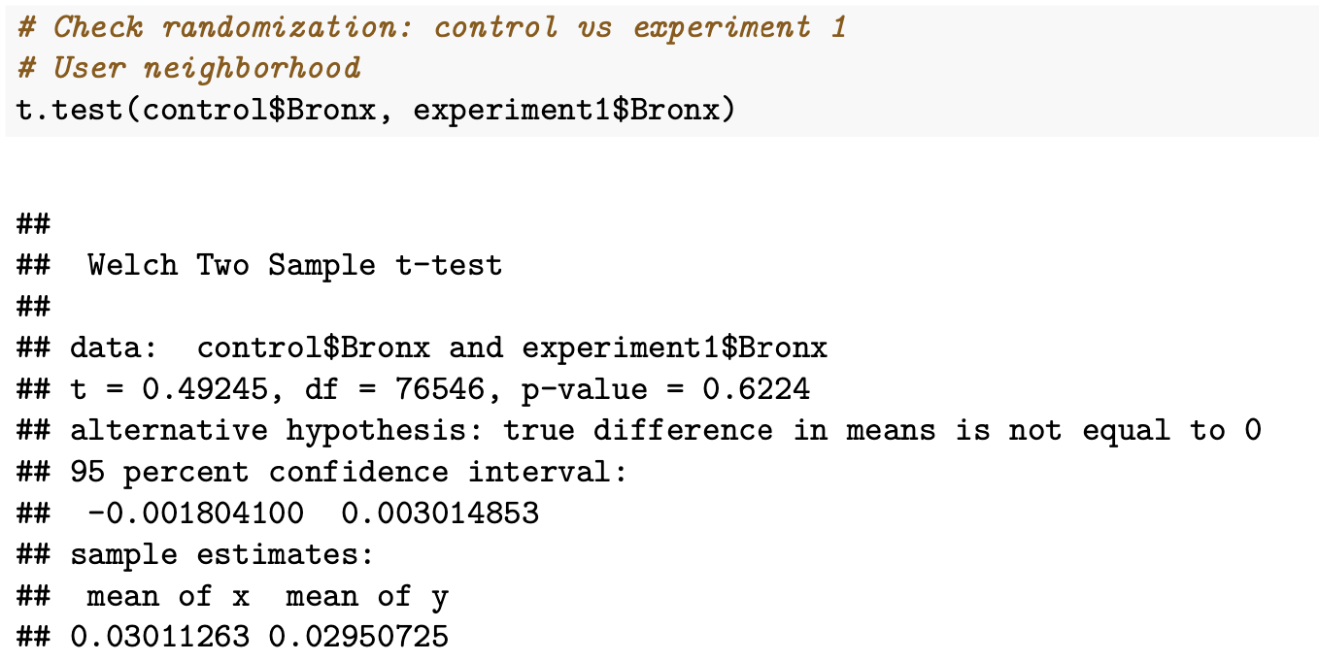
Sanity Check
Use T test to check if there is an difference in age/neighbor between control and treatment group
If p-value is greater than 0.05, two groups are similar.
16/18 of test pass, users in the control and treatment groups are randomized

Slide 20
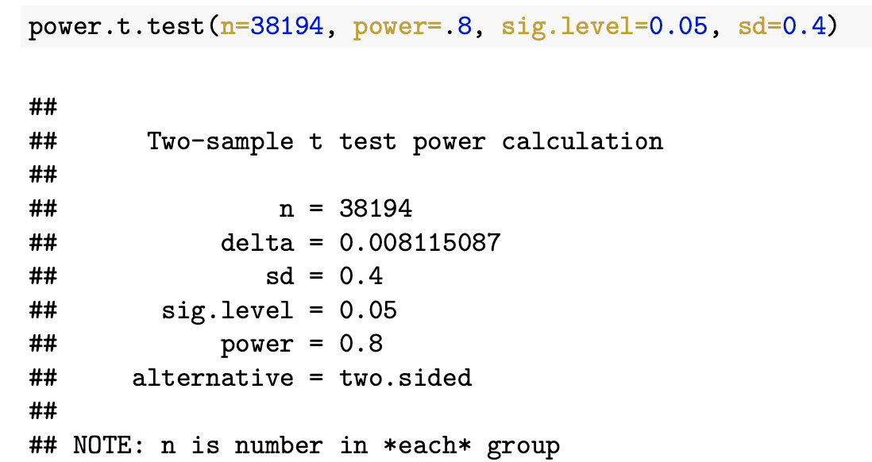
Sample Size Check
Expect to increase the conversion rate by 1% in the experiment
The current sample size can only detect a difference of 0.8%
Our experiment appears to be underpowered to detect the effect

Slide 21
Roadmap
Problem
& Data
Threats to
Causal Inference
Experiment
1
3
5
2
4
6
Experiment Hypothesis
Visualization
& Check
Recommendations
& Limitations

Slide 22
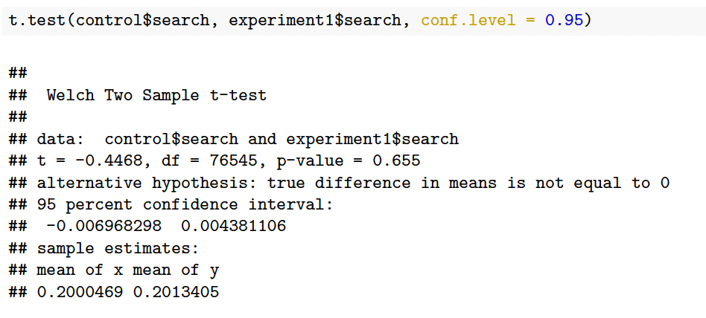
Results of the Experiment
Hypothesis 1
Redesign the text on the booking button would lead to more conversions
p-value > 0.05, failed to
reject the null hypothesis
The conversion has no difference between the control and experiment 1.

Slide 23
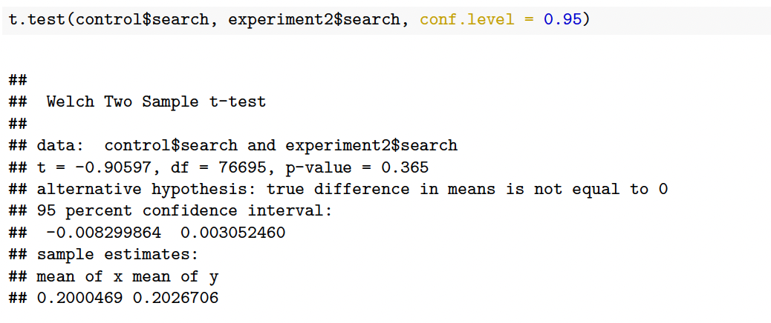
Results of the Experiment
Hypothesis 2
Remove the “tip included” text would lead to more conversions
p-value > 0.05, failed to
reject the null hypothesis
The conversion has no difference between the control and experiment 2.

Slide 24
Roadmap
Problem
& Data
Threats to
Causal Inference
Experiment
1
3
5
2
4
6
Experiment Hypothesis
Visualization
& Check
Recommendations
& Limitations

Slide 25
Recommendations
Don’t change these two features on Flyber’s UI
Conduct Usability Testing to find out the root cause of poor conversion rate

Slide 26

Limitations
Funnel impact may take a long term to get into effect
KPI requires long time periods and a very large sample to test for reliability
Experiments are underpowered to detect the effect

Slide 27
Thank You
for your attention

